Slide 1
Oracle 10g
INT 306
BY-HARGOBIND SINGH

Slide 2
Sql (STRUCTURED QUERY LANGUAGE)
SQL is a standard language for storing, manipulating and retrieving data in databases.
SQL is the standard language for Relational Database System. All the Relational Database Management Systems (RDMS) like MySQL, MS Access, Oracle, Sybase, Informix, Postgres and SQL Server use SQL as their standard database language.

Slide 3
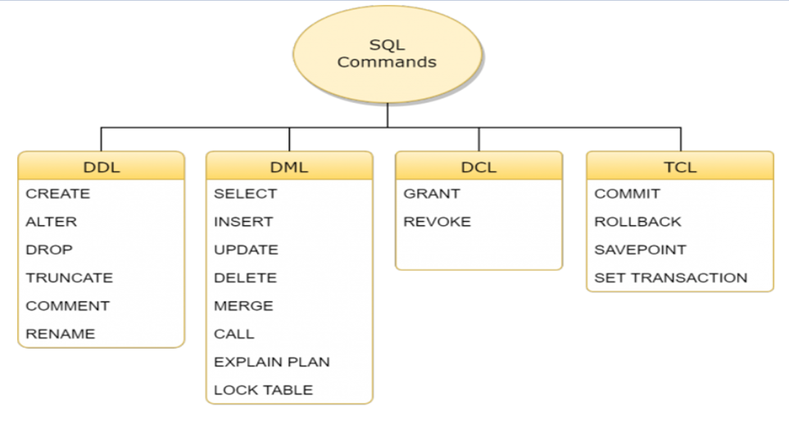
Sql commands

Slide 4
ddl
DDL is short name of Data Definition Language, which deals with database schemas and descriptions, of how the data should reside in the database.
  CREATE - to create a database and its objects like (table, index, views, store procedure, function, and triggers)
  ALTER - alters the structure of the existing database
  DROP - delete objects from the database
  TRUNCATE - remove all records from a table, including all spaces allocated for the records are removed
  COMMENT - add comments to the data dictionary
  RENAME - rename an object

Slide 5
DML
DML is short name of Data Manipulation Language which deals with data manipulation and includes most common SQL statements such SELECT, INSERT, UPDATE, DELETE, etc., and it is used to store, modify, retrieve, delete and update data in a database.
SELECT - retrieve data from a database
INSERT - insert data into a table
UPDATE - updates existing data within a table
DELETE - Delete all records from a database table
MERGE - UPSERT operation (insert or update)
CALL - call a PL/SQL or Java subprogram
EXPLAIN PLAN - interpretation of the data access path
LOCK TABLE - concurrency Control

Slide 6
DCL
DCL is short name of Data Control Language which includes commands such as GRANT and mostly concerned with rights, permissions and other controls of the database system.
GRANT - allow users access privileges to the database
REVOKE - withdraw users access privileges given by using the GRANT command

Slide 7
TCL
TCL is short name of Transaction Control Language which deals with a transaction within a database.
COMMIT - commits a Transaction
ROLLBACK - rollback a transaction in case of any error occurs
SAVEPOINT - to rollback the transaction making points within groups
SET TRANSACTION - specify characteristics of the transactio

Slide 8
data TYPES
char(n). Fixed length character string, with user-specified length n.
varchar(n). Variable length character strings, with user-specified maximum length n.
int. Integer (a finite subset of the integers that is machine-dependent).
smallint. Small integer (a machine-dependent subset of the integer domain type).
numeric(p,d). Fixed point number, with user-specified precision of p digits, with n digits to the right of decimal point.
real, double precision, float(n)

Slide 9
Create Table Construct
CREATE TABLE table_name ( column1 datatype, column2 datatype, column3 datatype, .... )
Example-
create table student (reg_no int , name varchar(20))

Slide 10
Inserting data
Insert into table_name (column1_name,column2_name….) values (value1,value2 ... )
Example-
insert into student(reg_no, name) values(101,’Virat’)

Slide 11
Data retrieval
Data can be fetched from a table by using select command
Select col1,col2.. from table_name
Select * from table_name (to view all the columns)
Example
select * from student

Slide 12
Create table using another table
A copy of an existing table can be created using a combination of the CREATE TABLE statement and the SELECT statement.
CREATE TABLE new_table_name AS SELECT column1, column2,...
FROM existing_table_name;
Example
create table student_copy as select * from student

Slide 13
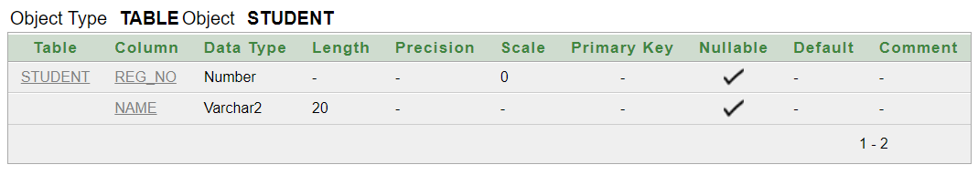
to check schema of table
Desc command is used to view schema/structure of a table
Desc table_name

Slide 14
SELECT DISTINCT Examples
The SELECT DISTINCT statement is used to return only distinct (different) values.
Syntax
SELECT DISTINCT column1, column2, ...
FROM table_name;
Example-
Select distinct reg_no from student;

Slide 15
SQL WHERE Clause
The WHERE clause is used to filter records.
It is used to extract only those records that fulfill a specified condition.
Syntax
SELECT column1, column2, ...
FROM table_name
WHERE condition;
Example
Select * from student where dept=‘cse’

Slide 16
SQL AND, OR and NOT Operators
The WHERE clause can be combined with AND, OR, and NOT operators.
The AND and OR operators are used to filter records based on more than one condition:
The AND operator displays a record if all the conditions separated by AND are TRUE.
The OR operator displays a record if any of the conditions separated by OR is TRUE.
The NOT operator displays a record if the condition(s) is NOT TRUE.

Slide 17
AND operator
Syntax
SELECT column1, column2, ...
FROM table_name
WHERE condition1 AND condition2 AND condition3 ...;

Slide 18
OR operator
Syntax
SELECT column1, column2, ...
FROM table_name
WHERE condition1 OR condition2 OR condition3 ...;

Slide 19
NOT operator
Syntax
SELECT column1, column2, ...
FROM table_name
WHERE NOT condition;

